Slide 1

INSTITUTE :UIE
DEPARTMENT: ALL ACADEMIC UNITS
Bachelor of Engineering (All Sections)
Subject Name and Code:
Engineering Physics 23SPH-141
Prepared by: Dr. Anjana Sharma, Assistant Prof. Physics
CRYSTALLOGRAPHY & ULTRASONICS
DISCOVER . LEARN . EMPOWER

Slide 2
COURSE OBJECTIVES
The course is designed to make the students industry ready to contribute in the growing demand of the industry at local, national and international level.
It will make the students competent to understand basic concepts and applications of advanced engineering physics and apply its principles in their respective fields at global platform.
It will enhance the skill level of the students and shall make them preferred choice for getting employment in industry and research labs.
It will give thorough knowledge of the discipline to enable students to disseminate knowledge in pursuing excellence in academic areas.

Slide 3
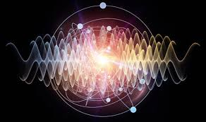
COURSE OUTCOMES
CO Number | Title On completion of this course, the students are expected to learn | Level
CO1 | Quote the basic fundamental concepts of lasers, optical fibres, crystallography, ultrasonic oscillations, semiconductor physics, quantum mechanics and nanotechnology. | Remember, Understand
CO2 | Demonstrate the working of various lasers, fibre components, semiconductor devices; explain the behaviour of crystalline solids, quantum and nano-scale systems. | Understand
CO3 | Solve problems by applying principles related to lasers, fibres, semiconductors, oscillations, quantum and nanoscience. | Applying
CO4 | Compare various lasers and fibres, semiconducting devices, crystalline materials, structures at quantum and nanoscale on the basis of their properties for industrial applications. | Analyze
CO5 | Develop various systems using lasers, fibres, semiconductors and nanomaterials for futuristic applications. | Design
Fig. 1 Introduction [1]

Slide 4
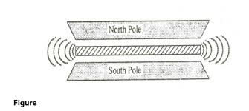
MAGNETOSTRICTION METHOD
Fig. 2 Introduction [2]

Slide 5
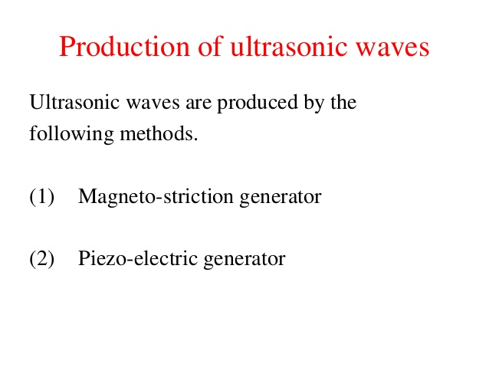
PRODUCTION OF ULTRASONIC WAVES

Slide 6
WORKING PRINCIPLE
Magnetostriction effect:
When a ferromagnetic rod like iron or nickel is placed in a magnetic field parallel to its length, the rod experiences a small change in its length. This is called magnetostriction effect.
The change in length (increase or decrease) produced in the rod depends upon the strength of the magnetic field, the nature of the materials and is independent of the direction of the magnetic field applied.

Slide 7
CONSTRUCTION
The circuit outline of magnetostriction ultrasonic generator is as appeared in the fig. A short for all time charged nickel bar is cinched in the center between two blade edges. A curl L₁ is twisted on the correct hand part of the bar. C is a variable capacitor. L₁ and C₁ shape the thunderous circuit of the gatherer tuned oscillator. Loop L₂ twisted on the LHS of the pole is associated in the base circuit. The curl L₂ is utilized as an input circle.
Fig. 3 Set up [2]

Slide 8
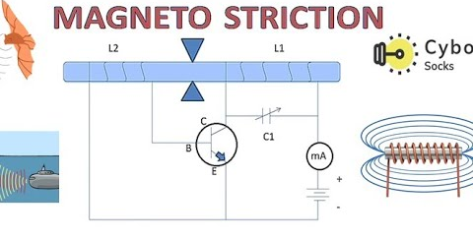
CIRCUIT DIAGRAM
Fig. 4 Set up [3]

Slide 9
WORKING
When the battery is switched on, the resonant circuit L₁C₁ sets up an alternating current frequency. This current flowing round the curl L₁ produces substituting attractive fields of recurrence f along the length of the nickel pole. The bar begins vibrating because of magneto strictive impact. The vibrations of the bar make ultrasonic waves.
The longitudinal development and compression of the bar delivers an E.M. in the loop L₂. This e.m.f is connected to the base of the transistor. Subsequently the plentifulness of high recurrence of high motions in curl L₁ is expanded because of positive criticism.
The created rotating current recurrence can be turned with the common recurrence of the pole by altering the capacitor.

Slide 10
CONDITION FOR RESONANCE IN CIRCUIT
The frequency of the vibration is given by
where P
= 1,2,3,4 ... etc. for fundamental, first over tone, second over tone etc.,
Y = Young’s modulus of the crystal and
ρ = density of the crystal.
•The variable condenser C1 is adjusted such that the frequency of the applied AC voltage is equal to the natural frequency of the quartz crystal, and thus resonance takes place.
•The vibrating crystal produces longitudinal ultrasonic waves of large amplitude.

Slide 11
ADVANTAGES AND DISADVANTAGES OF MAGENTOSTRICTION METHOD
Advantages
•The design of this oscillator is very simple and its production cost is low
At low ultrasonic frequencies, the large power output can be produced without the risk of damage of the oscillatory circuit.
Disadvantages
•It has low upper frequency limit and cannot generate ultrasonic frequency above 3000 kHz (i.e.3MHz).
•The frequency of oscillations depends on temperature.
•There will be losses of energy due to hysteresis and eddy current
.

Slide 12
SUMMARY
Introduction to Magentostriction Method
Working of Magentostriction Method
Advantages and Disadvantages
Application

Slide 13
FAQS
What is Magentostriction Method?
What is X-ray?
What are the advantages of Magentostriction method?
List disadvantages of Magentostriction method
What is the significance of Bragg’s law?
What is inverse piezoelectric method?

Slide 14
REFERENCES
[1] https://technopolitics.org/hacking-with-ultrasonic-waves/
[2] http://www.brainkart.com/article/Magnetostriction-Method--Principle,-Construction,-working,-Advantages-and-Limitations_6871/
[3] https://www.youtube.com/watch?v=qwSjq-keP3U
[2] http://www.vidyarthiplus.in/2011/11/engineering-physics-1-ultrasonic-and.html
[3] https://qph.fs.quoracdn.net/main-qimg-0eb8d712649cc744f6ade44bc469d3ec
[4] http://msheiksirajuddeen.blogspot.com/2011/10/magnetostriction-oscillator.html
[5] https://www.slideshare.net/raiuniversity/btech-sem-i-engineering-physics-u-v-chapter-2ultrasonic-waves
[6] https://www.youtube.com/watch?v=-XhWaUqndTI

Slide 15
THANK YOU
For queries
Email: anjana.e1643@cumail.in

